Slide 1
Aerosol Cloud Interactions
Ardit, Yuki, Konstantin

Slide 2
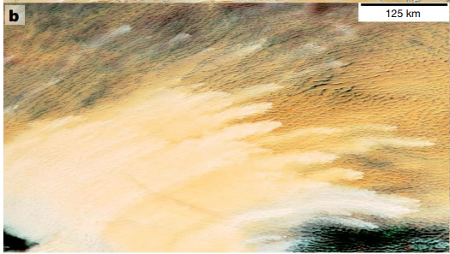
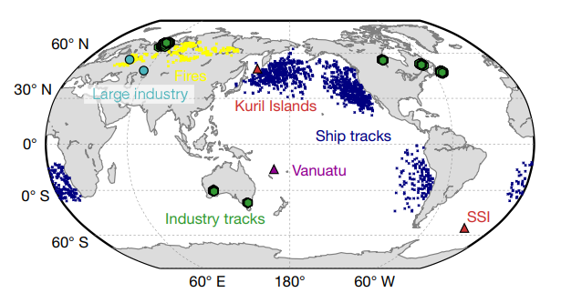
Driving hypothesis „Aerosols can change properties of low-level clouds“
Non-polluted clouds
Cloud modification process by aerosols
→Smoke (other aerosols) enter cloud
→increase in cloud droplets number concentration →increased reflectance (Twomey effect)
→rain suppression (Albrecht effect)
Wildfire smoke-polluted clouds
(Toll et al., 2019)
Workflow
Focus on a case study with smoke emissions
Investigation of cloud properties
Extension of analysis to other regions
Inclusion of other aerosol types
(Toll et al., 2019)

